Slide 1
How ML can help in Banking Sector
Presented by:
Mohammad Shaan (A21018)
Adarsh Raj (A21001)
Krishna prasad (A21016)
Mriganka Paul (A21019)
Avirup Saha (A21008)
Manpreet Singh (A21017)

Slide 2
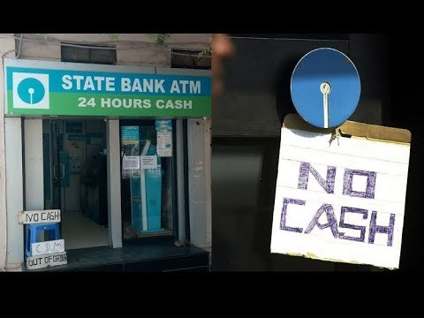
Business Problem
How Banks/WLAOs can avoid monetary penalty on non-availability of cash in ATMs
New RBI mandate wherein flat 10K penalty on cash outage
of more than 10 hrs a month
Effective October 1, 2021

Slide 3
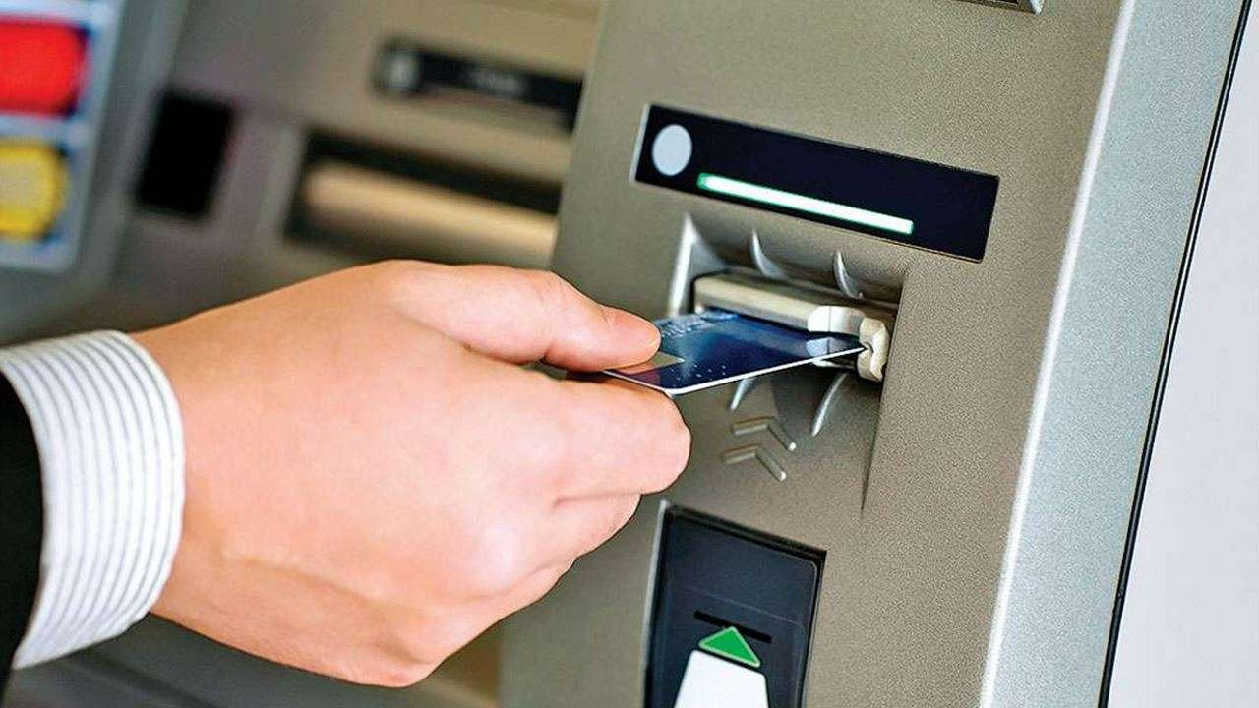
Data Needed
Bank Name
ATM ID
Amount that is loaded in the ATM everyday
Finish time of loaded cash
Population density of a particular location
Number of ATMs in a particular location
Date & Week of the Month
Money withdrawn on festivals/public holidays

Slide 4
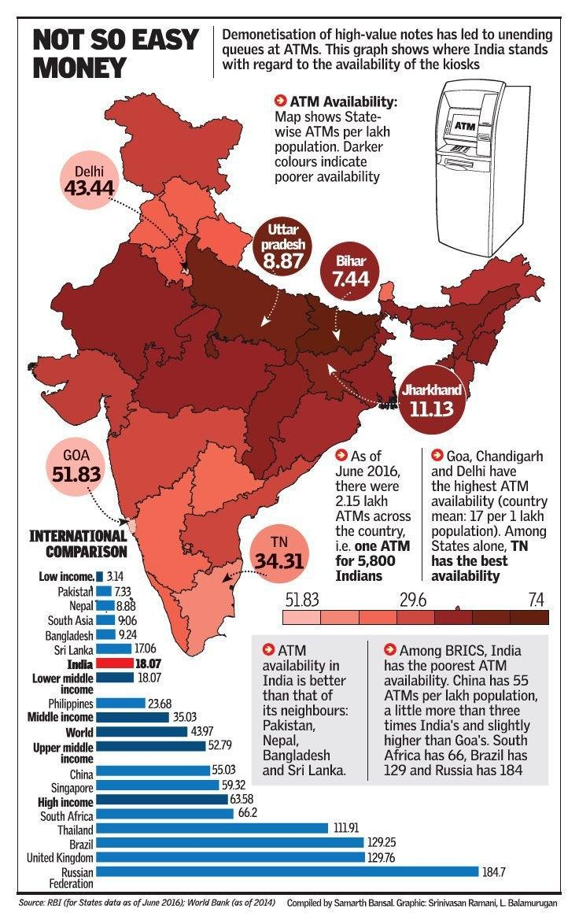
Assumptions
Amount loaded in the ATM finishes within that day itself
Other factors like locational importance etc. has not been considered
National holidays & Festival holidays are considered collectively under feature “Holidays”

Slide 5
Data Set
ATM name | Bank | In time for money | Amount Inserted | Day | Population density (no. of people per sq km) | Number of atms per sq km | Date | Week of the month | Holidays | Cash Finish time
ATM-1 | ICICI | 10 | 37424 | Monday | 10,000 | 2 | 13-10-2021 | 3 | N | 18
ATM-1 | ICICI | 13 | 75024 | Tuesday | 10,000 | 2 | 14-10-2021 | 3 | Y | 21
ATM-1 | ICICI | 11 | 20399 | Wednesday | 10,000 | 2 | 15-10-2021 | 3 | Y | 23
... | ... | ... | ... | ... | ... | ... | ... | ... | ... | ...
ATM-2 | ICICI | 8 | 189055 | Monday | 9000 | 3 | 13-10-2021 | 3 | N | 22
ATM-2 | ICICI | 9 | 160464 | Tuesday | 9000 | 3 | 14-10-2021 | 3 | Y | 23

Slide 6
Features to be used in the model
In time for money | Amount Inserted | Day | Population density (no. of people per sq km) | Number of atms per sq km | Week of the month | festivals / public holidays | Cash Finish time
10 | 37424 | Monday | 10,000 | 2 | 3 | N | 18
13 | 75024 | Tuesday | 10,000 | 2 | 3 | Y | 21
11 | 20399 | Wednesday | 10,000 | 2 | 3 | Y | 23
... | ... | ... | ... | ... | ... | ... | ...
8 | 189055 | Monday | 9000 | 3 | 3 | N | 22
9 | 160464 | Tuesday | 9000 | 3 | 3 | Y | 23

Slide 7
Feature Scaling and Distance Calculation
ATM name | Bank | Amount Inserted | Day | Distance | Cash Finish time(24 hrs)
0 | 0 | 0.143994642 | 0 | 0.066315473 | 18
0 | 0 | 0.53552803 | 0 | 0.325217914 | 20
….. | ….. | ….. | ….. | ….. | …..
0 | 0 | 0.472597936 | 1 | 1.033825372 | 22
Did the below:
Calculated the Hamming distance for the categorical features
Calculated the Min-Max Normalization for the feature which is continuous.
Calculated the Euclidean distance using both the categorical and continuous features.
Note : Link to the excel

Slide 8
Implementing K-NN Model
ATM name | Bank | Amount Inserted | Day | Distance | Cash Finish time(24 hrs) | K Value | Mean (Time in 24 hrs)
0 | 0 | 0.143994642 | 0 | 0.066315473 | 18 | 1 | 18.00
0 | 0 | 0.53552803 | 0 | 0.325217914 | 20 | 2 | 19.00
….. | ….. | ….. | ….. | ….. | ….. | ….. | …..
1 | 0 | 0.472597936 | 1 | 1.033825372 | 22 | 6 | 20.25
Test Data:
Atm Name : Area 1
Bank: Bank 1
Amount Inserted:
50,000
Day: Monday
Cash Finish Time: 19.05 hrs

Slide 9
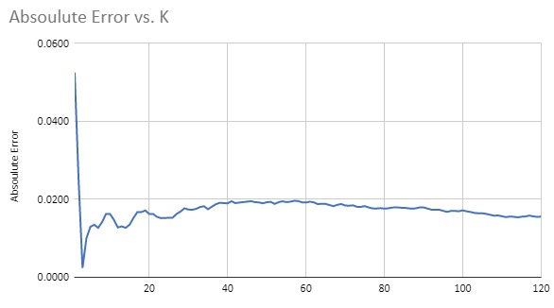
Graphical representation

Slide 10

Business Impact
Impacts for this problem can be segregated into :
Financial impact on industries -
Ease of doing business
Free flow of cash in economy
Consumer relationship /feedback -
eg.CRISIL ranking
Quality service
Avoiding penalties due to RBI rules.
Adhering to covid precautionary measures.
Link : https://thefinancialbrand.com/98254/future-atms-banking-cash-mobile-digital/

Slide 11


